Slide 1
WebSphere Application Server WebSphere Troubleshooting and Performance Lab
Notes:
XMLFEP_Install.ppt
Page 1 of 32

Slide 2
Agenda
What is it?
What’s in it?
How to run it?
Major Recommended Tools
Demo
References
Tips
Q&A
Notes:
XMLFEP_Install.ppt
Page 2 of 32

Slide 3
What is it?
Self-paced, free, publicly downloadable WebSphere Liberty and WAS traditional troubleshooting and performance lab
Learn: CPU analysis, Hang determination, Performance tuning, Memory analysis, etc.
Over 100 pages of exercises which can be done in sequence or a la carte
Hosted on Quay.io
Install podman or Docker Desktop for Windows and macOS
podman/docker run ... quay.io/ibm/webspherelab (see instructions for details)
VNC/Remote Desktop into the lab
Notes:
XMLFEP_Install.ppt
Page 3 of 32

Slide 4
What’s in it?
Derby
tWAS 9.0.5.14
daytrader7
IHS
JMeter
OpenLDAP
Liberty 23.0.0.1
daytrader7
Derby
Fedora 37 Linux
Podman/Docker
Windows, macOS or Linux Host
Notes:
XMLFEP_Install.ppt
Page 4 of 32

Slide 5
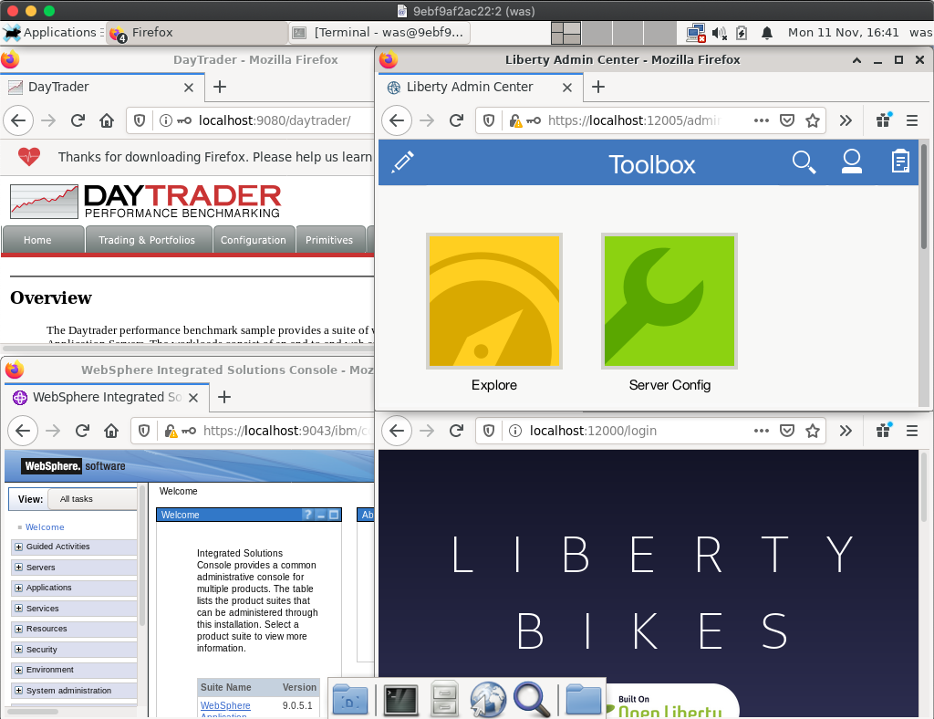
Screenshot
Notes:
XMLFEP_Install.ppt
Page 5 of 32

Slide 6
Major Recommended Tools
Tool | Analyze | Purpose
top -H or equivalent | CPU by Thread | Performance/Hang
monitor-1.0 / AdminCenter | Various statistics | Performance/Hang
requestTiming-1.0 & Access Log | Response times | Performance/Hang
Thread and Monitor Dump Analyzer (TMDA) | Thread dumps | Performance/Hang
Garbage Collection and Memory Visualizer (GCMV) | Verbose garbage collection | Performance/Hang
Eclipse Memory Analyzer Tool (MAT) | Heapdumps | OutOfMemoryError
Java Health Center | IBM Java | CPU Deep Dive
Notes:
XMLFEP_Install.ppt
Page 6 of 32

Slide 7
How to run it?
Windows/macOS: Configure Docker Desktop or podman:
Memory >= 4GB
Disk >= 30GB
Run the container from Command Prompt or Terminal:
podman run --cap-add sys_chroot --rm -p 5901:5901 -p 5902:5902 -p 3390:3389 -p 9080:9080 -p 9443:9443 -it quay.io/ibm/webspherelab
docker run --rm -p 5901:5901 -p 5902:5902 -p 3390:3389 -p 9080:9080 -p 9443:9443 -it quay.io/ibm/webspherelab
Wait 5 minutes until you see:
========= = READY = =========
Notes:
XMLFEP_Install.ppt
Page 7 of 32

Slide 8
How to run it?
Remote into the container:
VNC to localhost:5902
From the Terminal in macOS: open vnc://localhost:5902
Linux Terminal: vncviewer localhost:5902
Windows 3rd party VNC viewers
Windows Remote Desktop: Requires configuration; see lab appendix
Perform the step-by-step lab: https://github.com/IBM/webspherelab/blob/main/Liberty_Perf_Lab.md
Also available on the desktop inside the lab
Notes:
XMLFEP_Install.ppt
Page 8 of 32

Slide 9
Demo
Notes:
XMLFEP_Install.ppt
Page 9 of 32

Slide 10
Thank you.
Questions?
Notes:
XMLFEP_Install.ppt
Page 10 of 32

